Slide 1
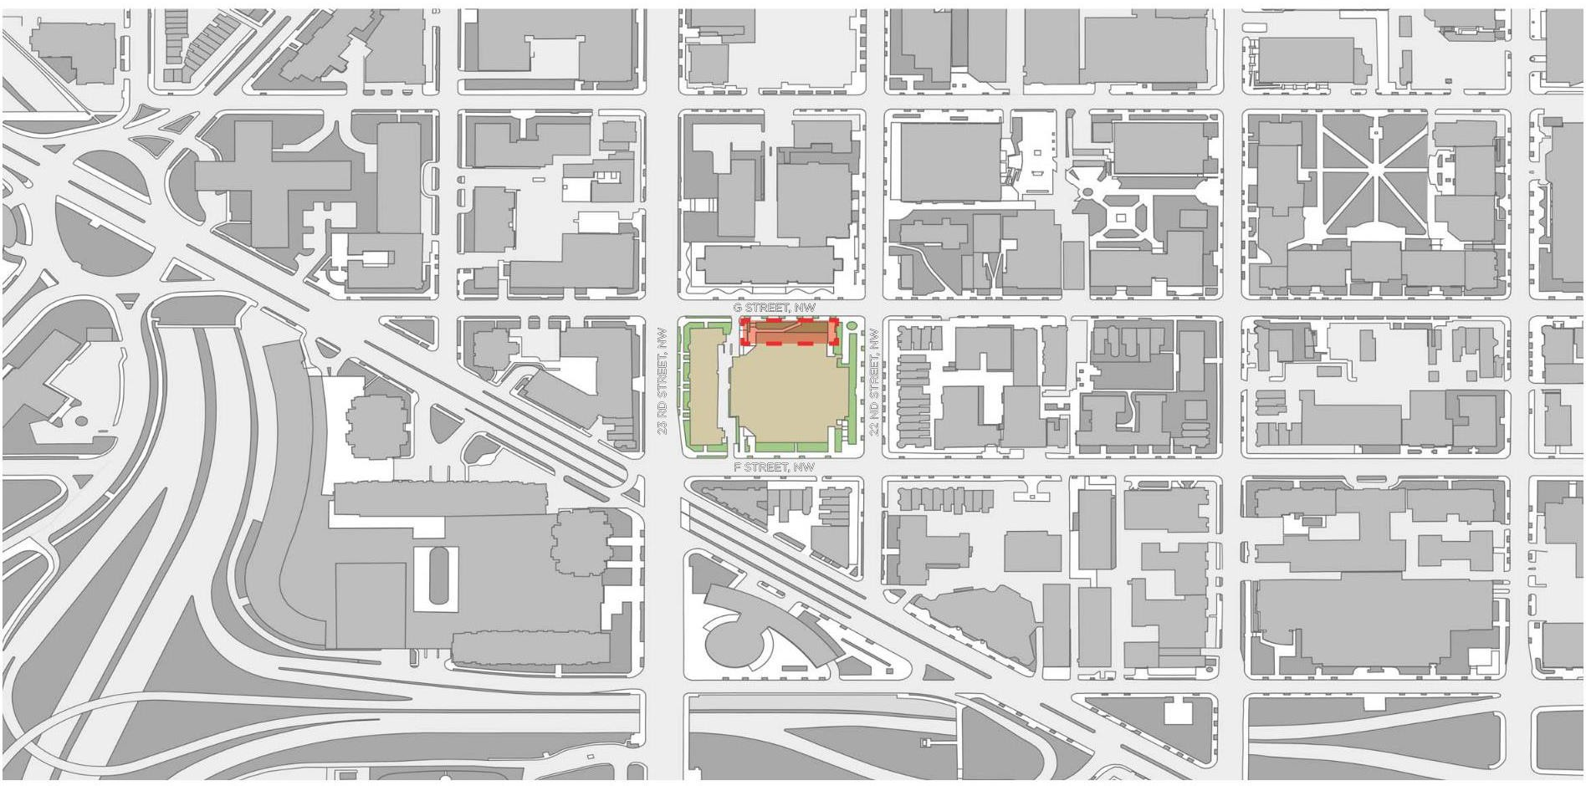
CHARLES E. SMITH RENOVATION
The George Washington University – Square 57
October 18, 2023
00 | SITE LOCATION

Slide 2
CHARLES E. SMITH RENOVATION
The George Washington University – Square 57
October 18, 2023
PROJECT INFORMATION
Zone: RA-4
Existing Building Floor Area: Proposed Gross Floor Area Added:
Existing Building with New Floor Area:
Percent-Increase in Floor Area: 2.3%
64,973sf
1,500sf
66,473 sf
Depth of Proposed Addition: 10-feet Height of Proposed Addition: 36-feet
PROJECT FEATURES
Demolish existing swimming pool and associated spaces
Expansion of existing Auxiliary Gym for basketball practice (necessary to fit regulation-size court) Repurpose pool areas for basketball practice and teams support spaces
Façade of proposed addition will mimic design of existing facade
01 | PROJECT INFORMATION

Slide 3
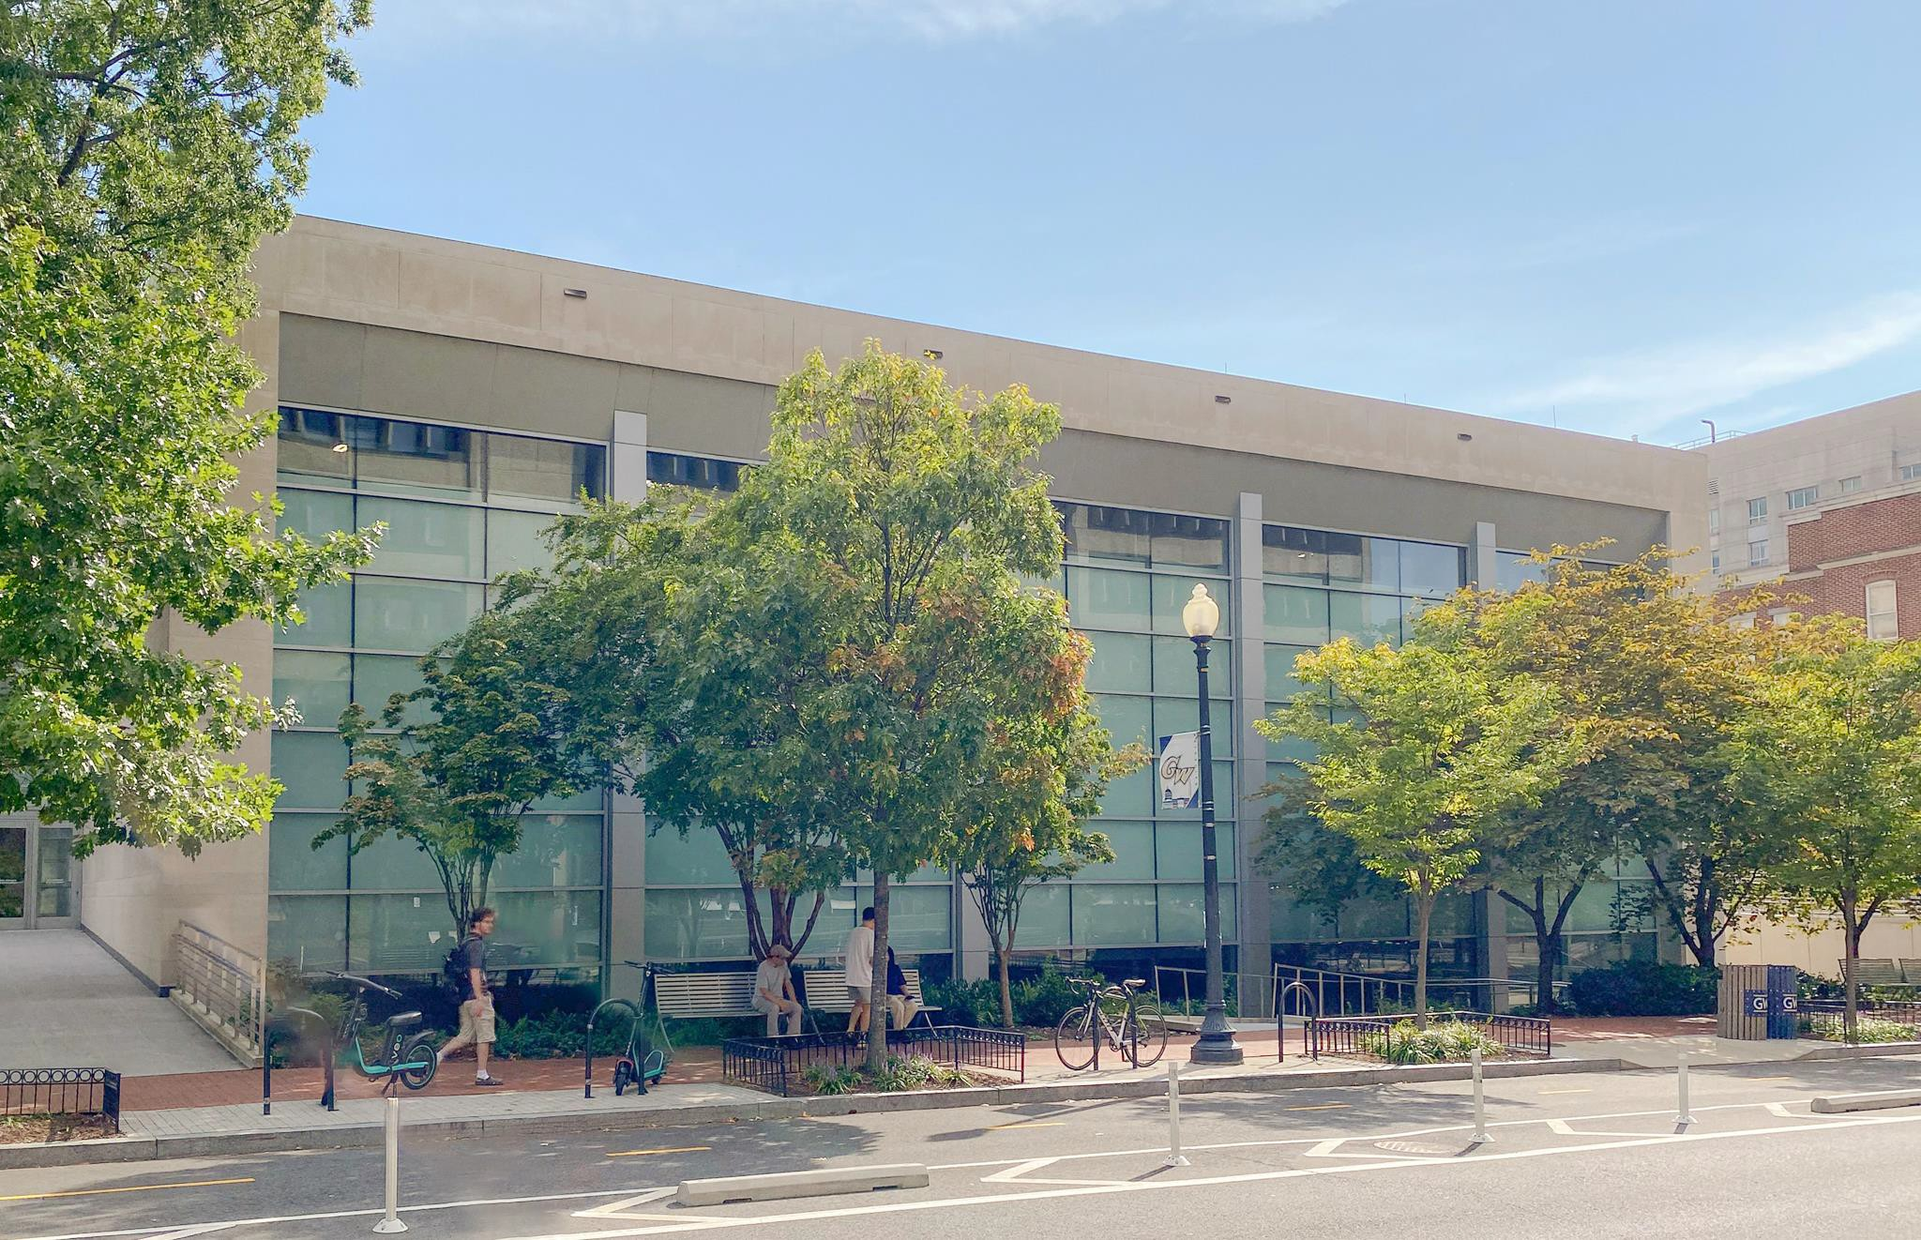
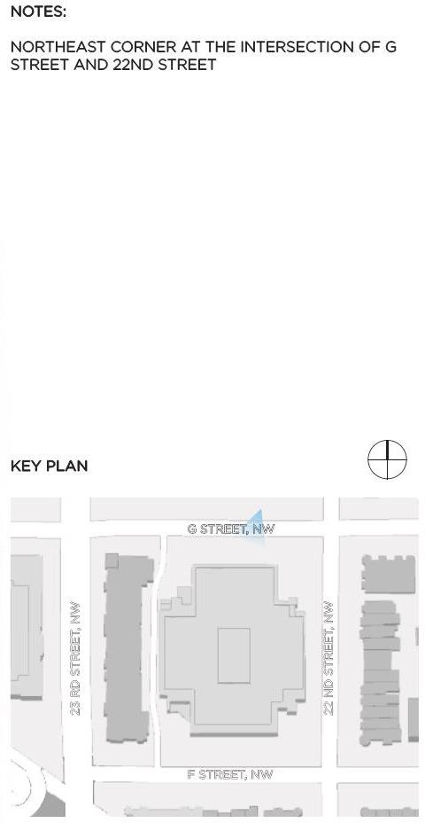
CHARLES E. SMITH RENOVATION
The George Washington University – Square 57
October 18, 2023
02 | SITE PHOTO

Slide 4
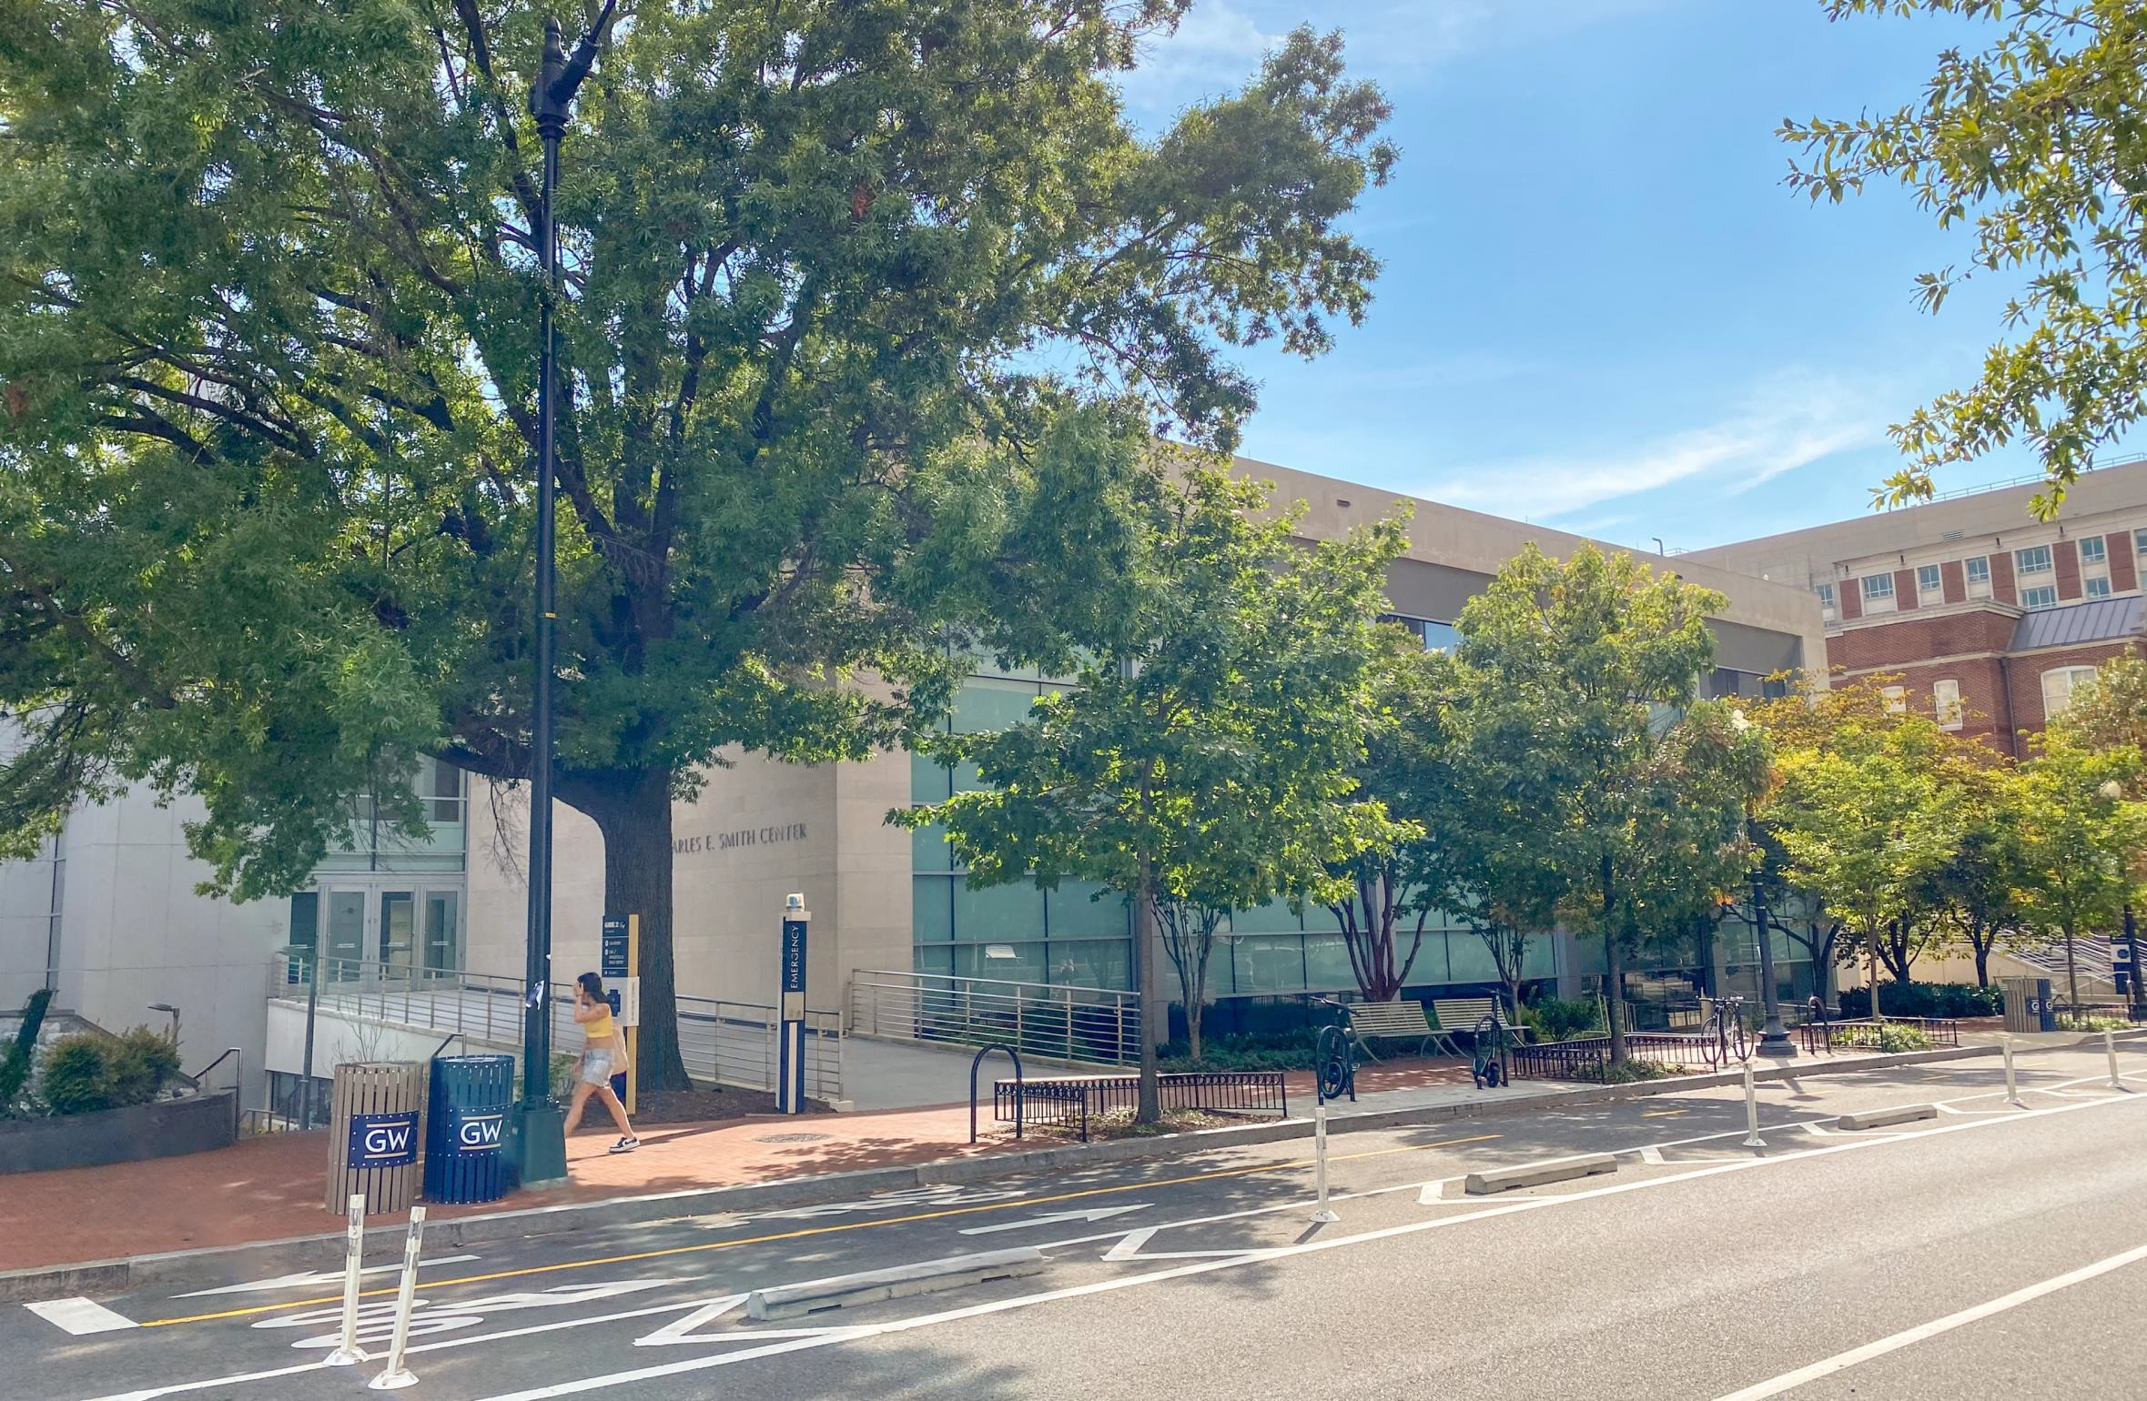
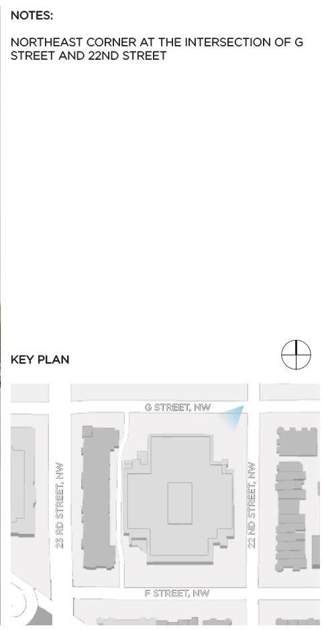
CHARLES E. SMITH RENOVATION
The George Washington University – Square 57
October 18, 2023
03 | SITE PHOTO

Slide 5
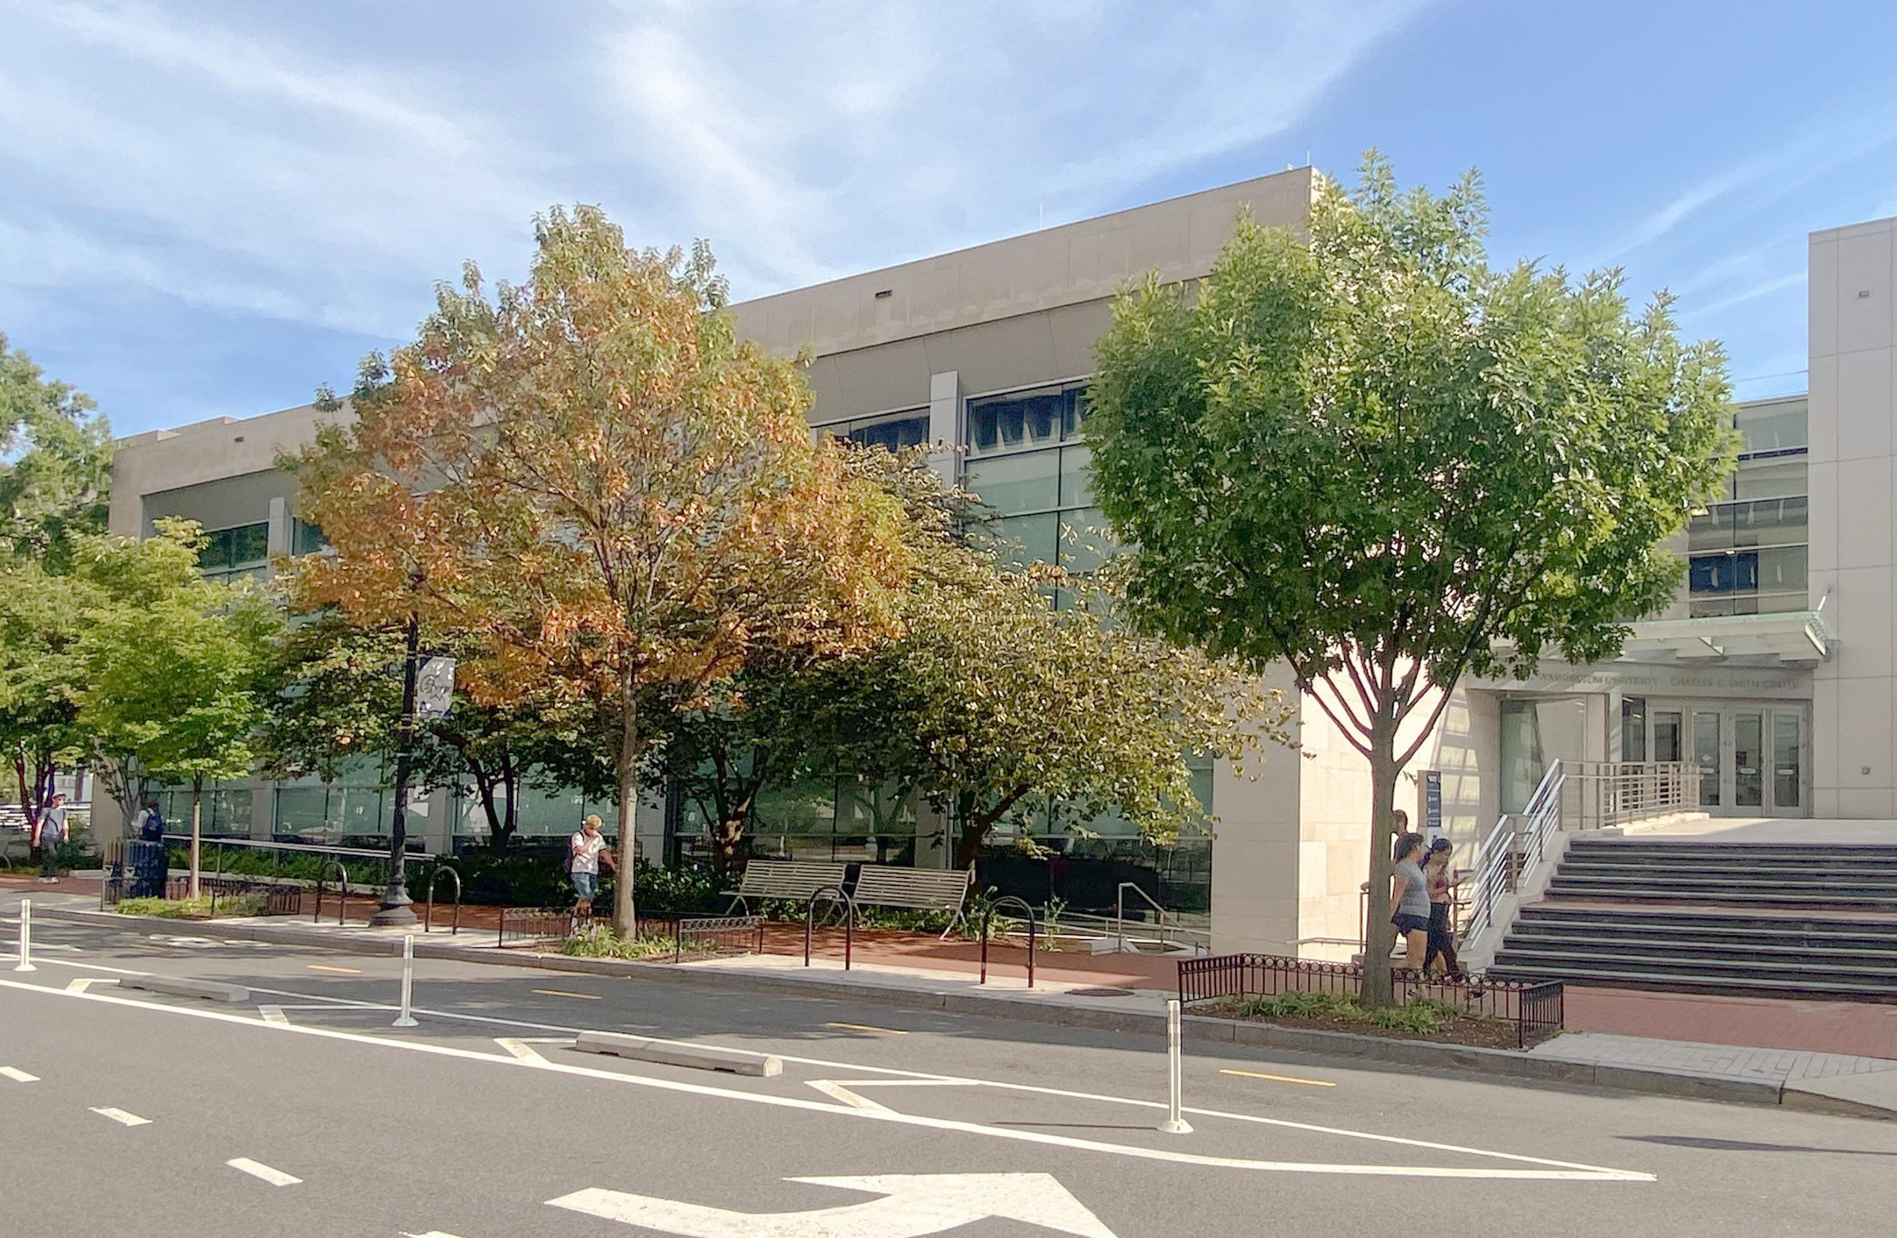
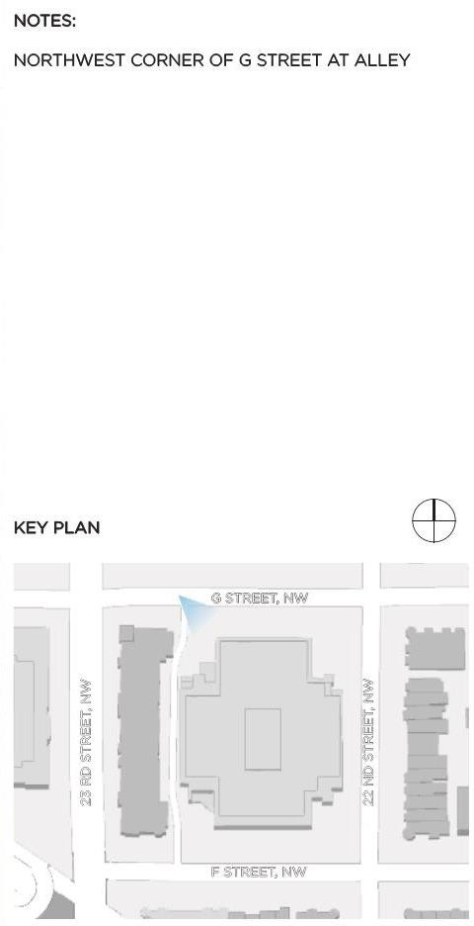
CHARLES E. SMITH RENOVATION
The George Washington University – Square 57
October 18, 2023
04 | SITE PHOTO

Slide 6
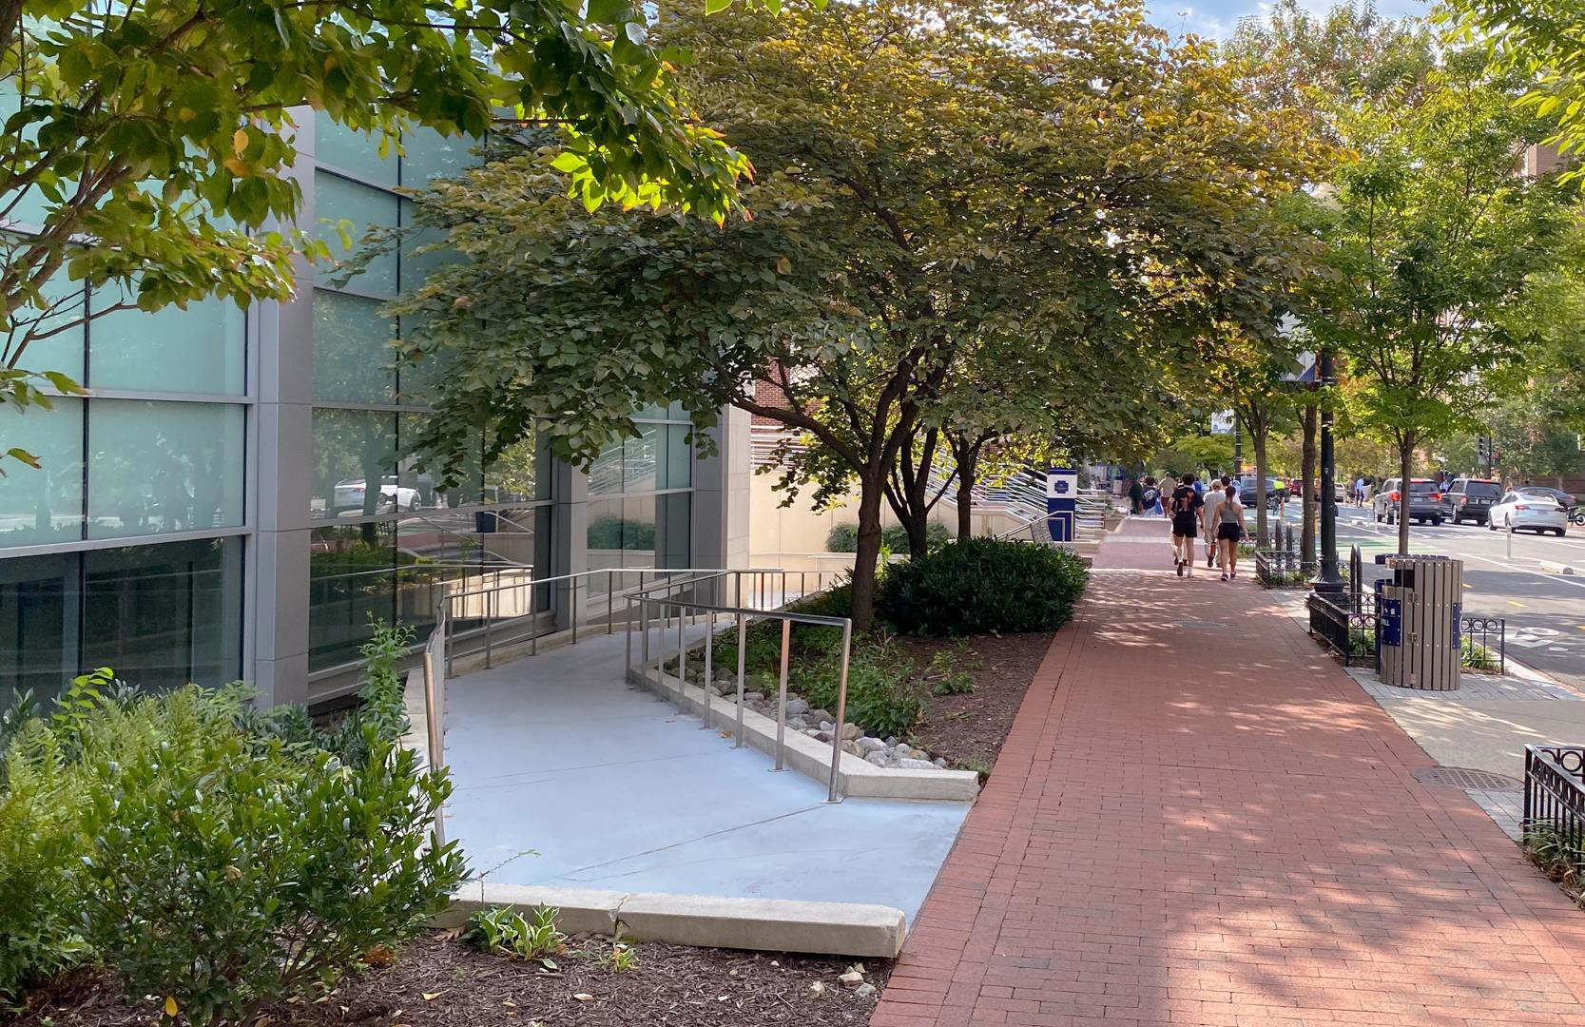
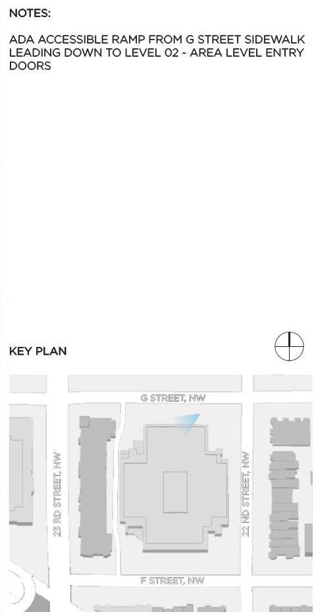
CHARLES E. SMITH RENOVATION
The George Washington University – Square 57
October 18, 2023
05 | SITE PHOTO

Slide 7
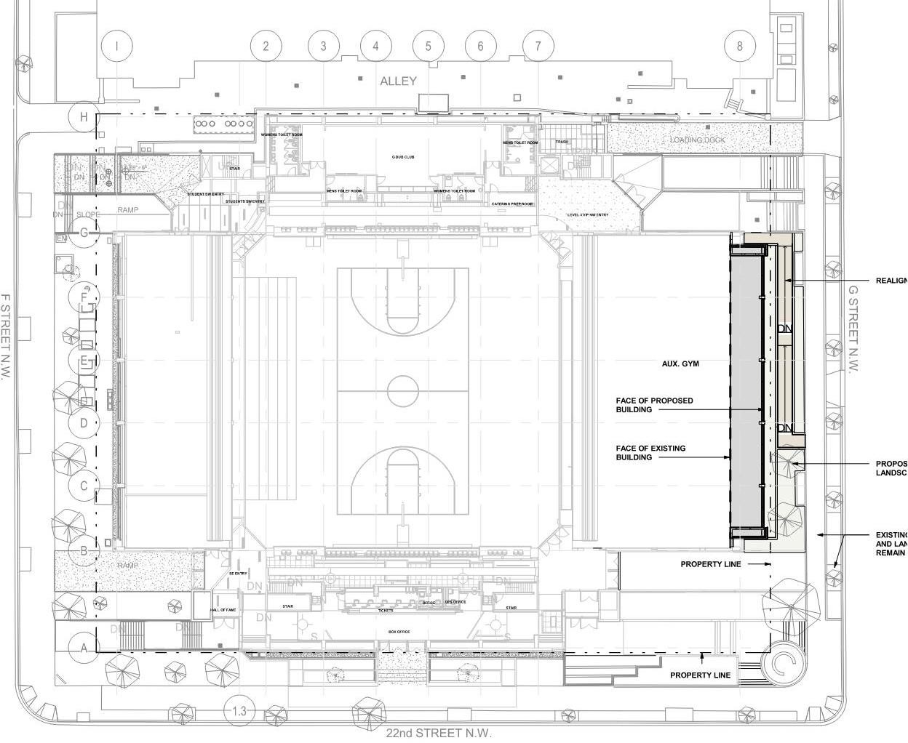
CHARLES E. SMITH RENOVATION
The George Washington University – Square 57
October 18, 2023
06 | SITE PLAN

Slide 8
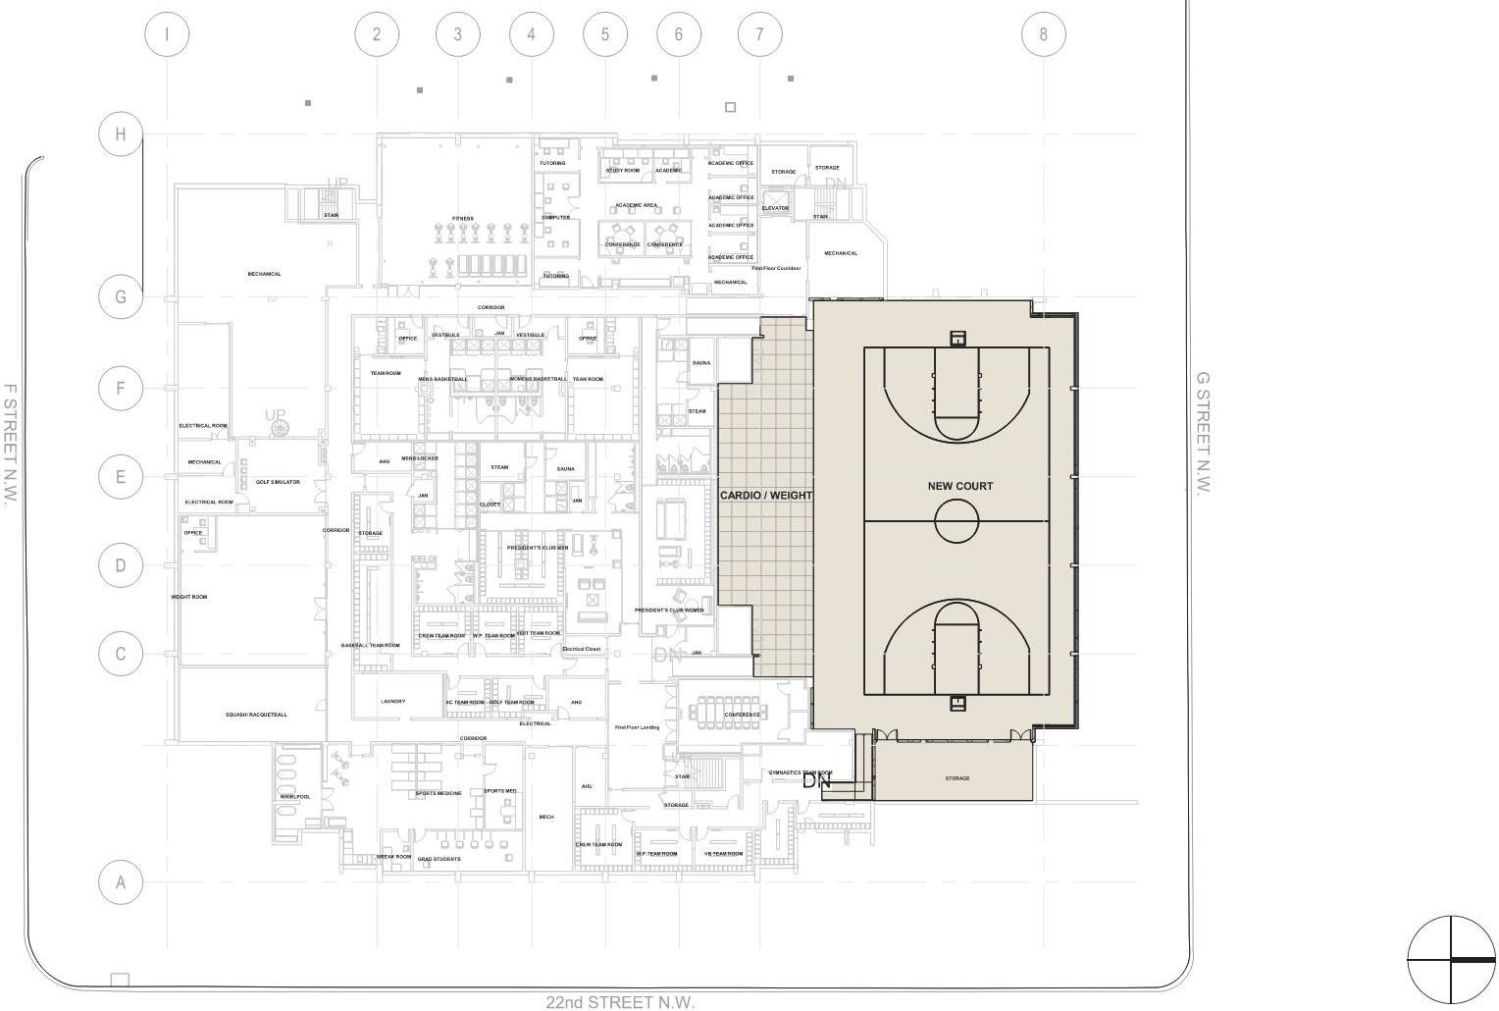
CHARLES E. SMITH RENOVATION
The George Washington University – Square 57
October 18, 2023
07 | LEVEL 01 FLOOR PLAN

Slide 9
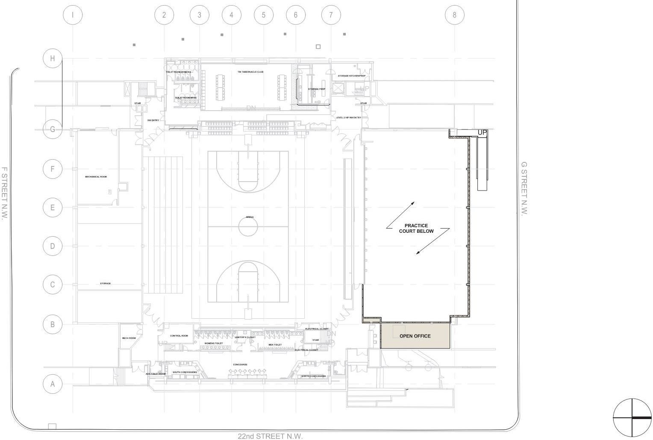
CHARLES E. SMITH RENOVATION
The George Washington University – Square 57
October 18, 2023
08 | LEVEL 02 – ARENA FLOOR PLAN

Slide 10
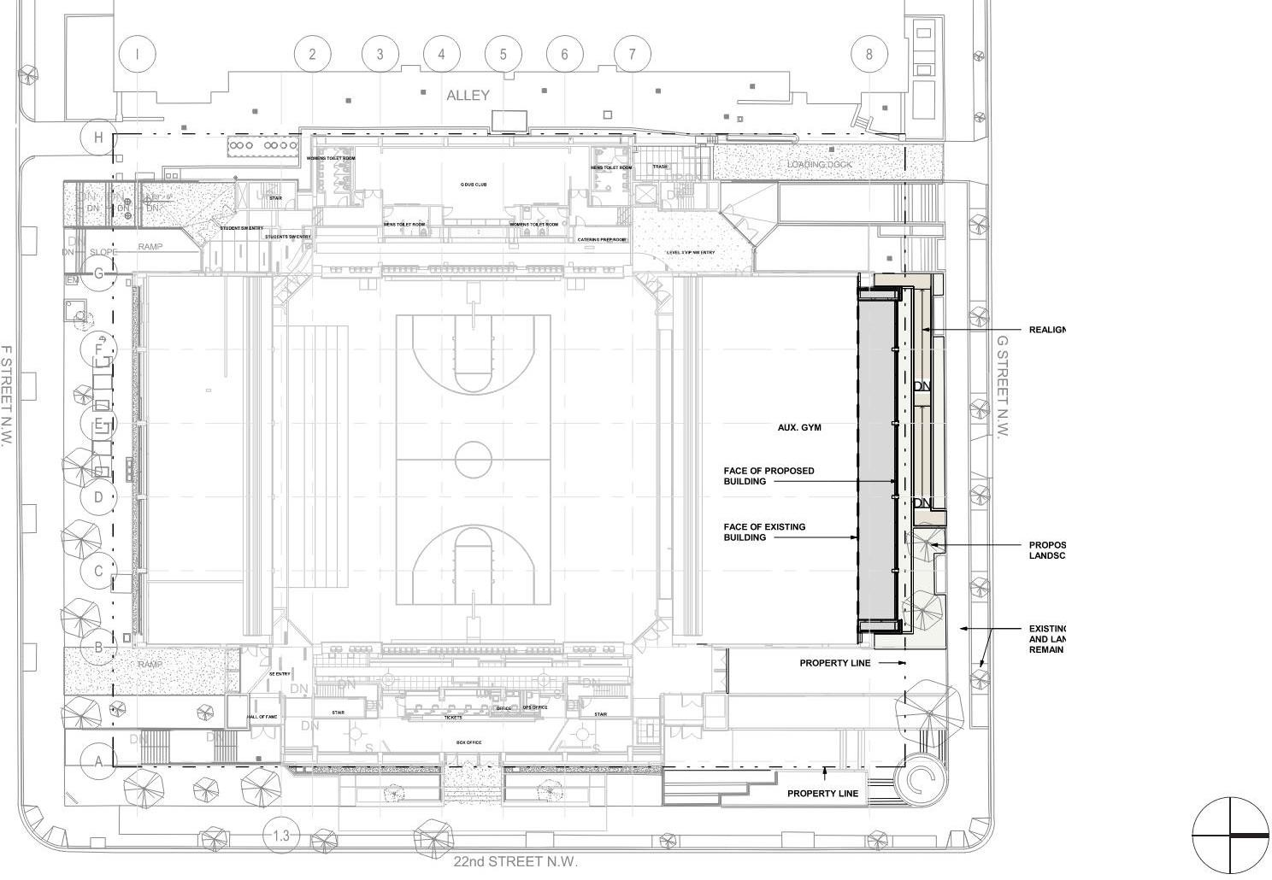
CHARLES E. SMITH RENOVATION
The George Washington University – Square 57
October 18, 2023
09 | LEVEL 03 – ARENA CONCOURSE PLAN

Slide 11
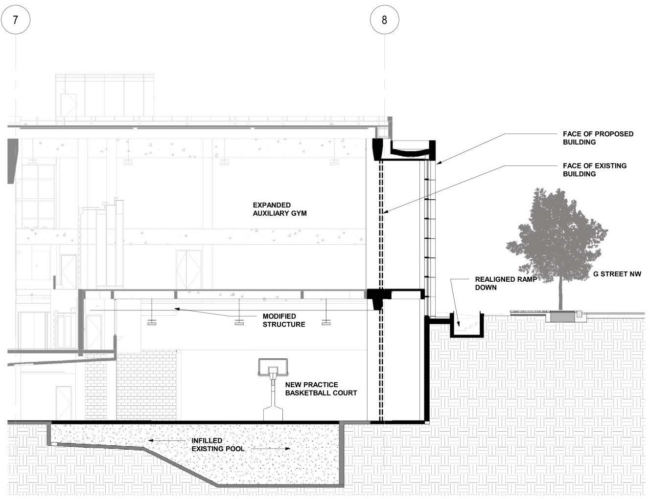
CHARLES E. SMITH RENOVATION
The George Washington University – Square 57
October 18, 2023
10-Feet
36-Feet
10 | SECTION OF NORTH FACADE

Slide 12
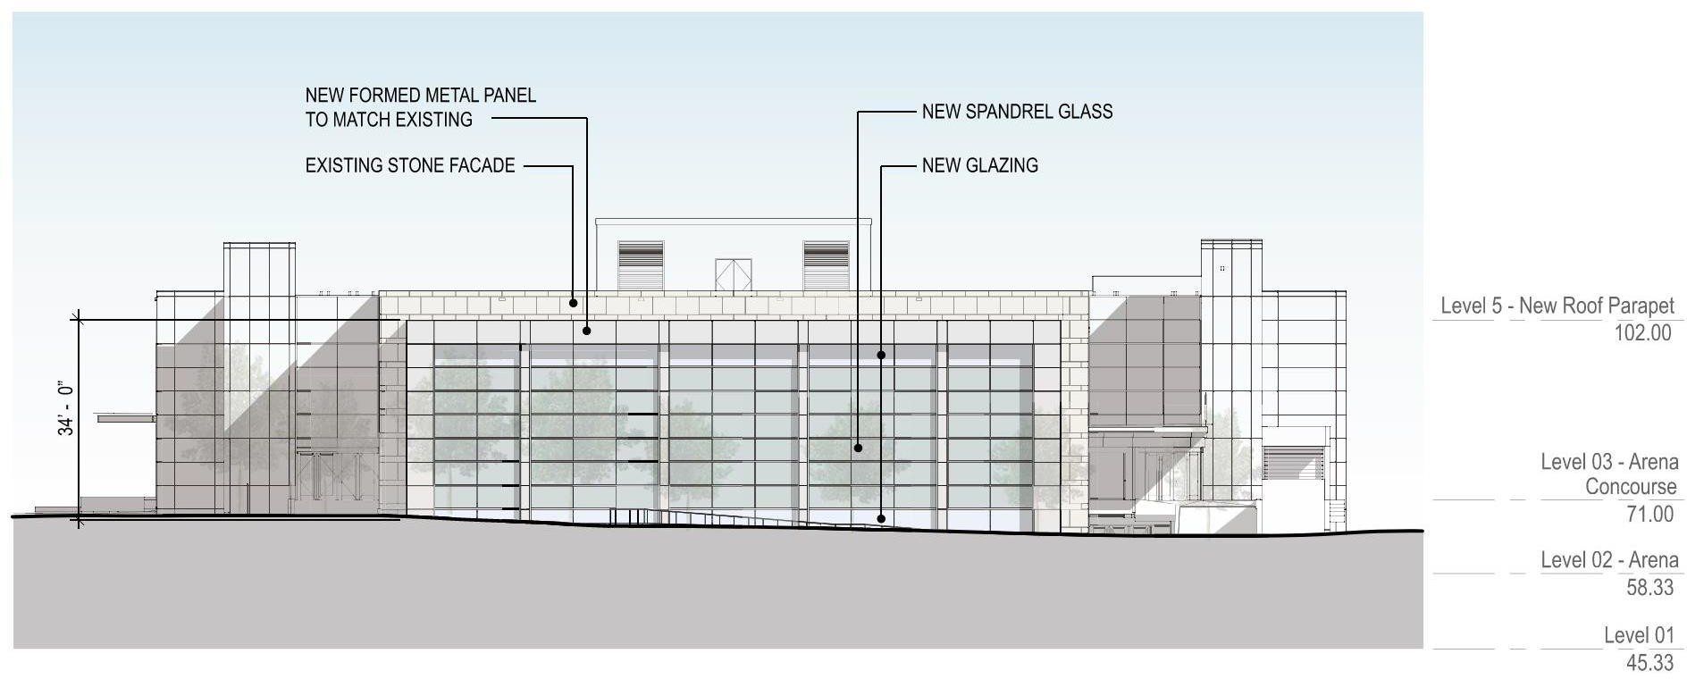
CHARLES E. SMITH RENOVATION
The George Washington University – Square 57
October 18, 2023
11 | NORTH ELEVATION

Slide 13
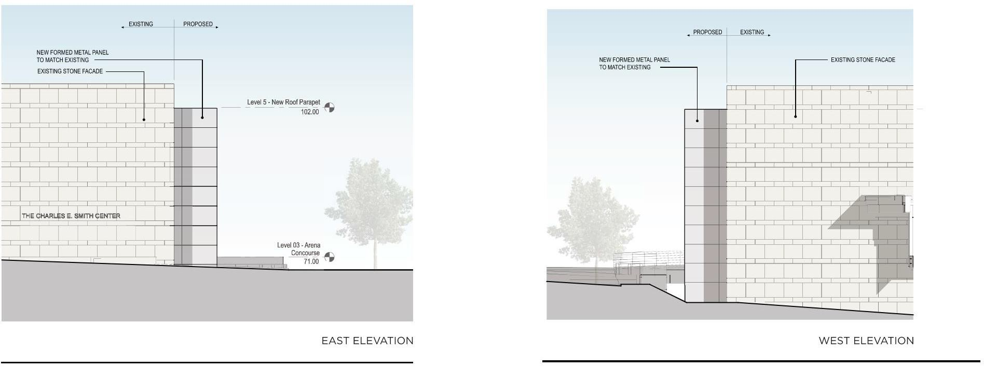
CHARLES E. SMITH RENOVATION
The George Washington University – Square 57
October 18, 2023
12 | EAST/WEST ELEVATION

Slide 14
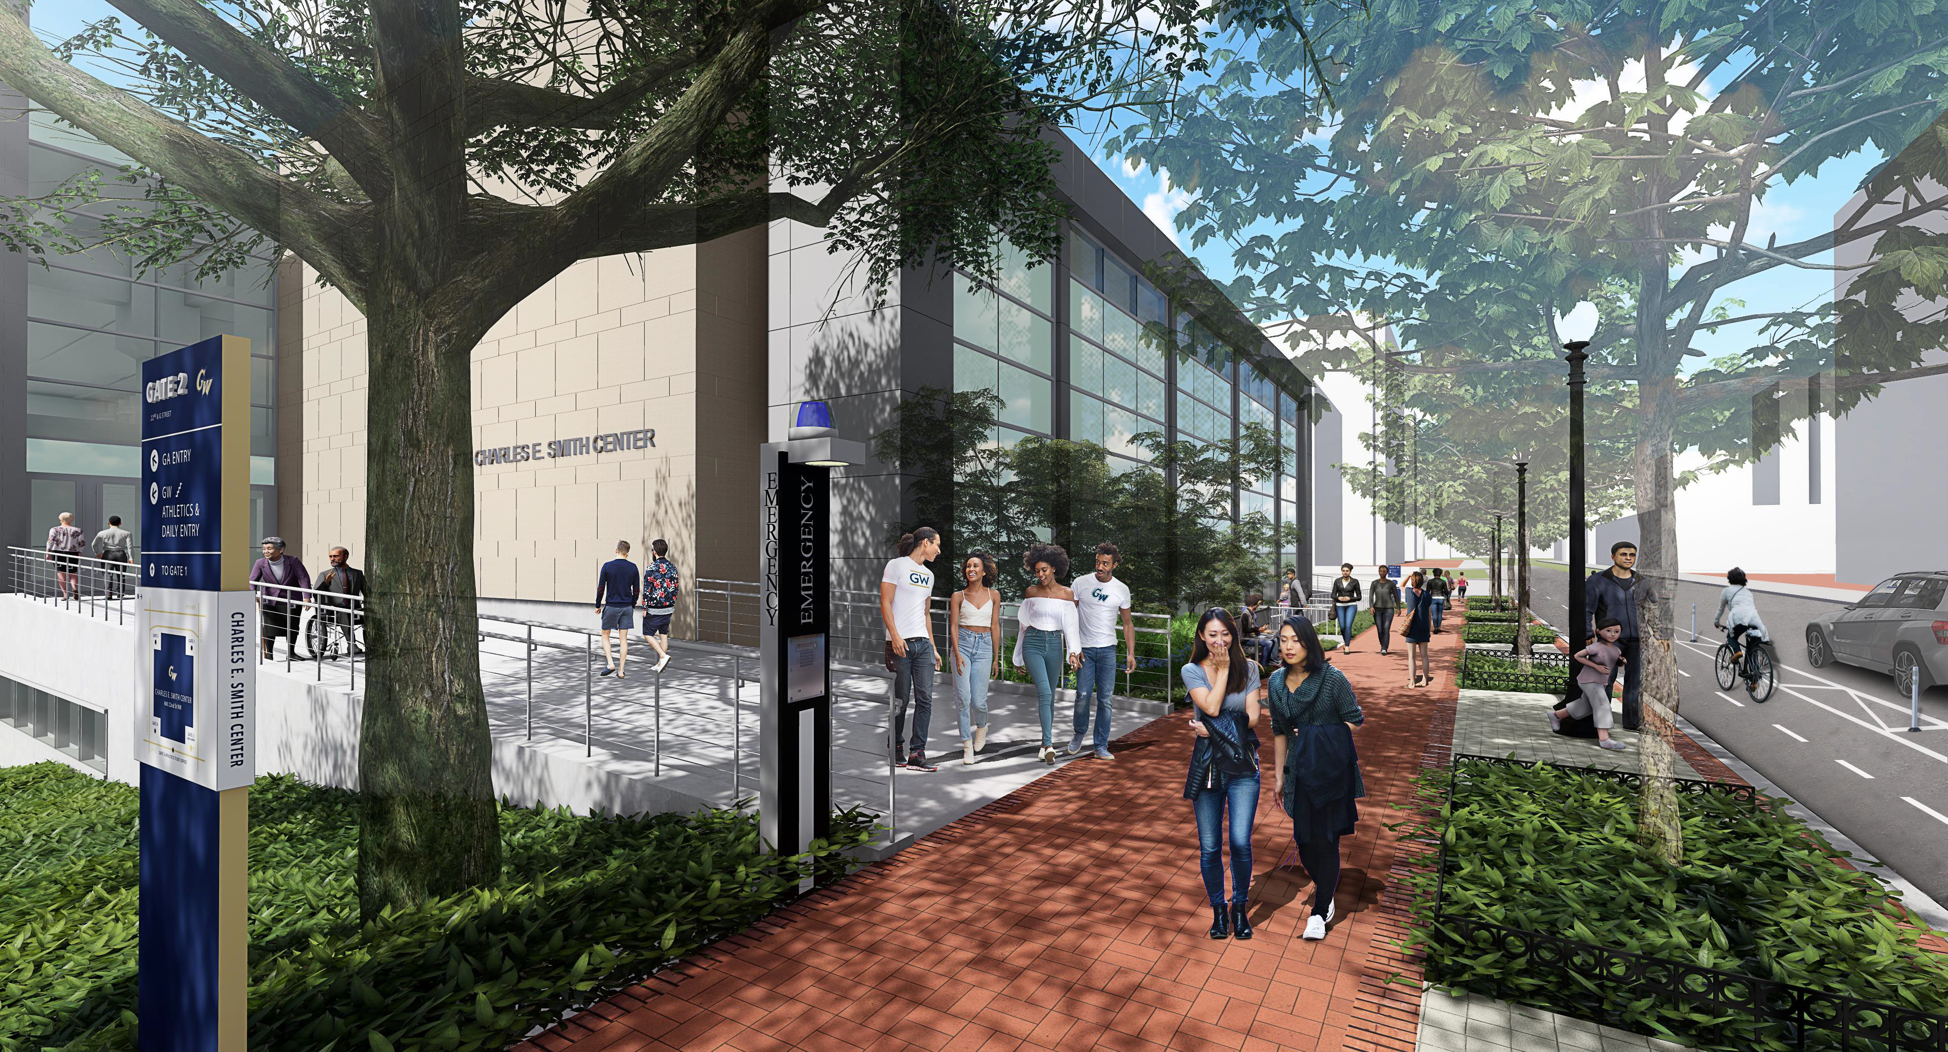
CHARLES E. SMITH RENOVATION
The George Washington University – Square 57
October 18, 2023

Slide 15
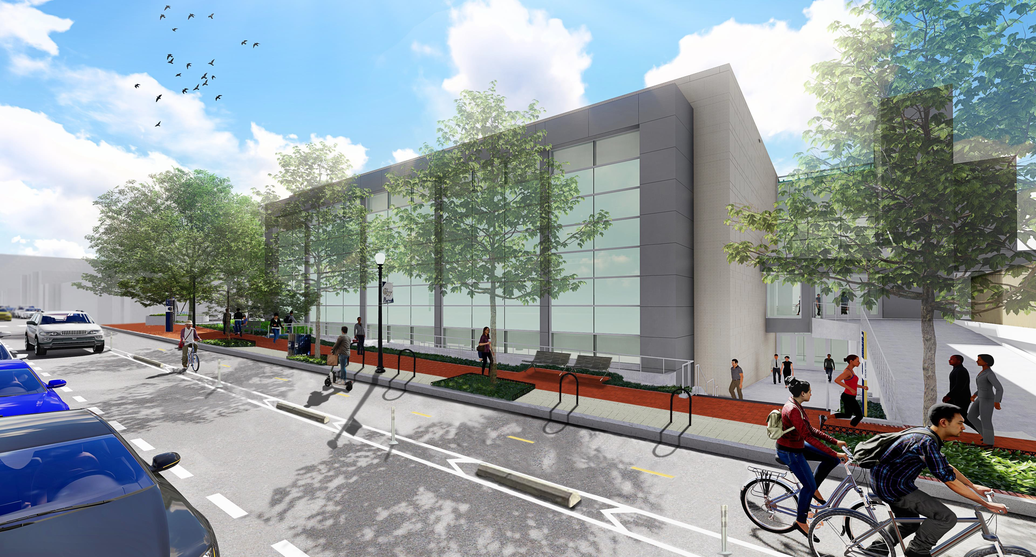
CHARLES E. SMITH RENOVATION
The George Washington University – Square 57
October 18, 2023

Slide 16
CHARLES E. SMITH RENOVATION
The George Washington University – Square 57
October 18, 2023
ZONING APPLICATION
The Property was not designated as a “development site” in the 2007 Campus
Plan/PUD; therefore, modification of the Campus Plan/PUD is required to
designate the Smith Center as a “development site.”
Zoning Approvals Needed:
Amendment to the University’s 2007 Foggy Bottom Campus Plan
Modification of the First-Stage Planned Unit Development (“PUD”)
Second-Stage PUD Approval of the Project
Modification to Further Processing Approval

Slide 17
CHARLES E. SMITH RENOVATION
The George Washington University – Square 57
October 18, 2023
THANK YOU!
QUESTIONS AND COMMENTS

